Slide 1
Comparative Analysis of AlexNet and DenseNet for Pneumonia Detection using Chest X-ray Images

Slide 2
Introduction
Pneumonia, a lung infection, can be caused by bacteria or viruses.
Pneumonia claims the lives of 1.4 million children annually, making up 18% of under-five child fatalities worldwide.Globally, two billion people suffer from pneumonia each year.
The good news: Pneumonia is treatable with antibiotics and antiviral drugs.
Challenges: Chest X-rays, the current diagnostic method, often produce unclear images, leading to misclassifications.
Our Goal: Develop an automated system to detect bacterial and viral pneumonia from digital X-ray images.
We'll discuss advancements in accurate pneumonia detection using two pre-trained deep Convolutional Neural Networks (CNNs): AlexNet and DenseNet.

Slide 3
Literature Review
Tawsifur Rahman et al.,[1] presents a study focused on the development of an automated system for pneumonia detection using deep learning techniques, specifically Convolutional Neural Networks (CNNs). The researchers employ four pre-trained CNN models, including AlexNet, ResNet18, DenseNet201, and SqueezeNet, and implement transfer learning to facilitate the detection of pneumonia and its differentiation into bacterial and viral pneumonia. The study outlines the methodology, which involves dataset preparation and preprocessing steps, and assesses the performance of the CNN models in various classification schemes. Among the models, DenseNet201 proves to be the most effective, achieving high accuracy and demonstrating superior performance metrics. The research's potential impact lies in its ability to enhance computer-aided pneumonia diagnosis, especially in resource-limited settings, offering the potential to expedite accurate disease detection and save lives.

Slide 4
Literature Review
Alisha Imran et al.,[2] addresses the critical issue of pneumonia diagnosis by developing a Convolutional Neural Network (CNN) capable of automatically detecting pneumonia, both bacterial and viral, from chest X-ray images. By utilizing a dataset of 5,863 X-ray images, categorized into normal and pneumonia cases, the problem is framed as a binary classification task. The author employs transfer learning, utilizing the pre-trained VGG19 model, and explains the model training process, where the CNN's parameters are iteratively adjusted to improve prediction accuracy. The trained model achieves an impressive 88% accuracy, showcasing the potential of CNNs to significantly enhance the efficiency and accuracy of pneumonia diagnosis, ultimately benefiting patients and healthcare professionals alike.

Slide 5
Literature Review
Vikash chouhan et al.,[3] introduces an innovative deep learning framework for pneumonia detection in chest X-ray images, addressing the critical global health issue of pneumonia caused by viruses, bacteria, and fungi. Leveraging transfer learning and ensemble modeling, the study utilizes pre-trained neural networks (AlexNet, DenseNet121, ResNet18, InceptionV3, and GoogLeNet) and employs data augmentation techniques to enhance model generalization. The ensemble model, combining predictions from these networks, achieves a remarkable accuracy of 96.4% and an outstanding recall of 99.62%, surpassing individual models and previous studies. This approach significantly contributes to the field of medical image analysis, offering a robust solution for accurate pneumonia diagnosis, with potential implications for global healthcare.

Slide 6
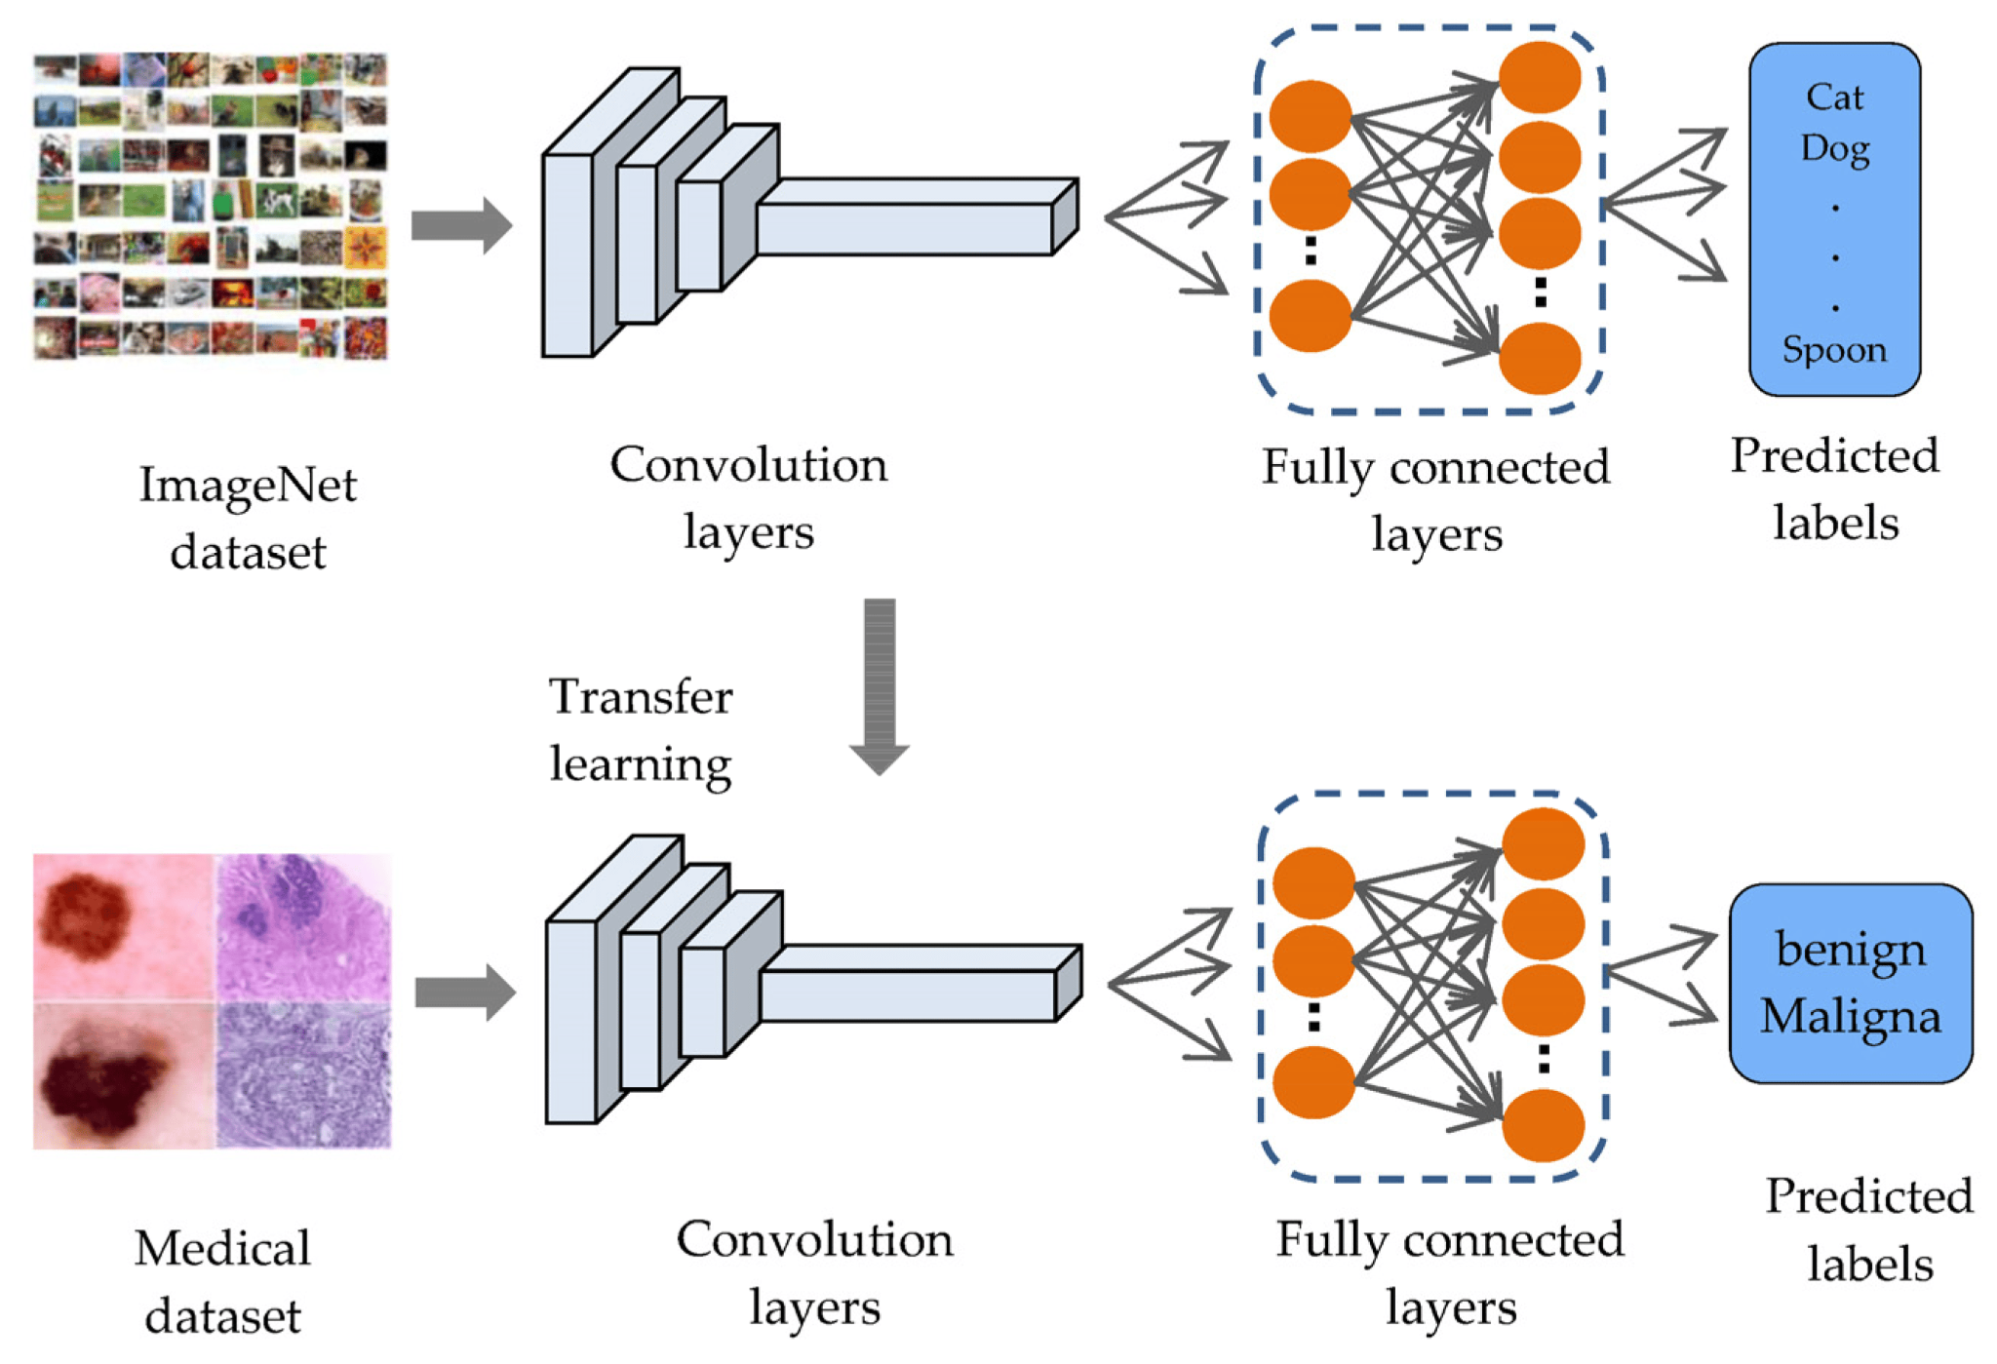
The Concept of Transfer Learning

Slide 7
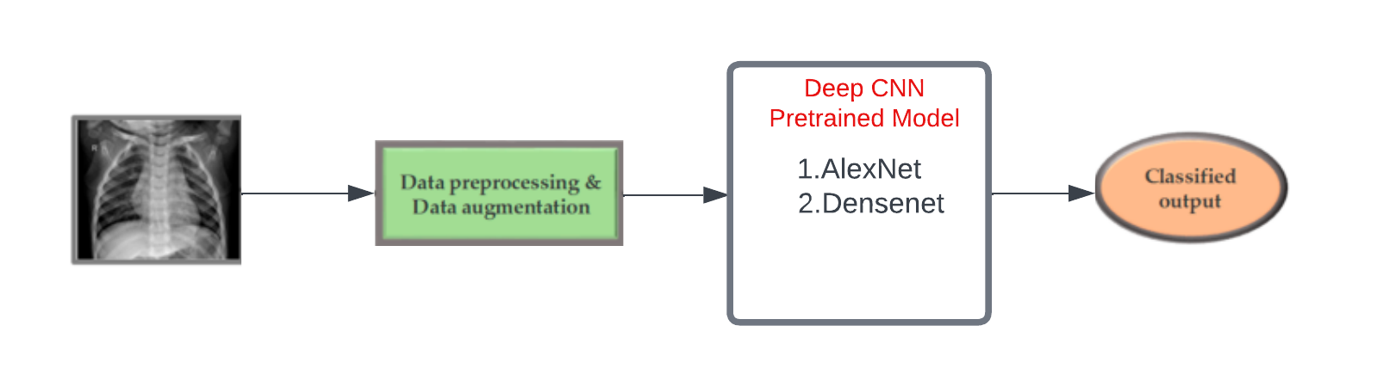
Proposed Methodology
Fig. Overview of the methodology.

Slide 8
Dataset: We are using a dataset with 5,863 X-ray images from Kaggle, divided into two categories (Pneumonia/Normal) for our pneumonia detection task. To ensure robust model evaluation, the dataset is split into training, validation, and test sets.
Preprocessing: One of the important steps in the data preprocessing was to resize the X-ray images as the image input for different algorithms were different. For AlexNet the images were resized to 227 × 227 pixels and for DenseNet 201 the images were resized to 224 × 224 pixels. All images were normalized according to the pre-trained model standards.
Data augmentation enhances our model's ability to recognize patterns by exposing it to a variety of image perspectives.
Augmentation technique: Rotation,Translation and Scaling

Slide 9
We've chosen two powerful models, AlexNet and DenseNet, known for their success in image tasks. While training and results are pending, we believe these models will guide our pneumonia detection project.
After training, we'll compare results using metrics like accuracy and precision, presenting findings and insights to identify the better-performing model and areas for improvement.

Slide 10
References
[1] Tausif Ur Rahman , Muhammad E. H. Chowdhury, Amith Khandakar, Khandaker R. Islam, Khandaker F. Islam, Zaid B. Mahbub, Muhammad A. Kadirand Saad Kashem (2020) Transfer Learning with Deep Convolutional Neural Network (CNN) for Pneumonia Detection Using Chest X-ray.
[2] Alisha Imran (2019) Training a CNN to detect Pneumonia.
https://medium.datadriveninvestor.com/training-a-cnn-to-detect-pneumonia-c42a44101deb
[3] Vikas Chouhan,Sanjay Kumar Singh,Aditya Khampari,Deepak Gupta,Prayag Tiwari,Catarina Moreira,Robertas Damaševičius and Victor Hugo C. de Albuquerque (2020) A Novel Transfer Learning Based Approach for Pneumonia Detection in Chest X-ray Images.

